Slide 1

Business Model of Shopify:
In this presentation, we will explore Shopify's business model and how its users generate revenue through it.

Slide 2
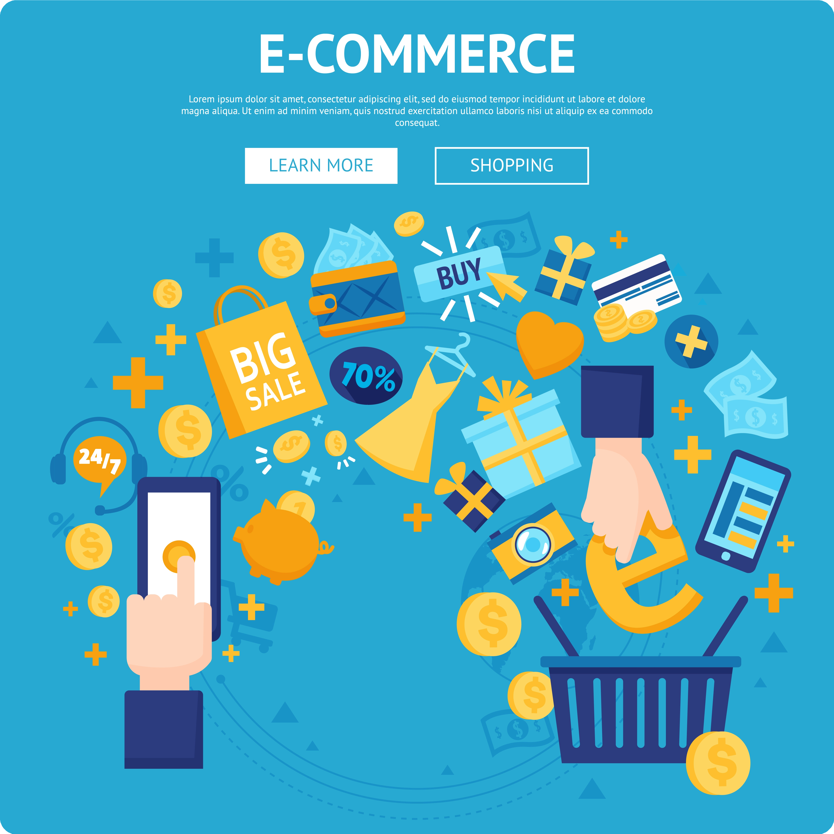
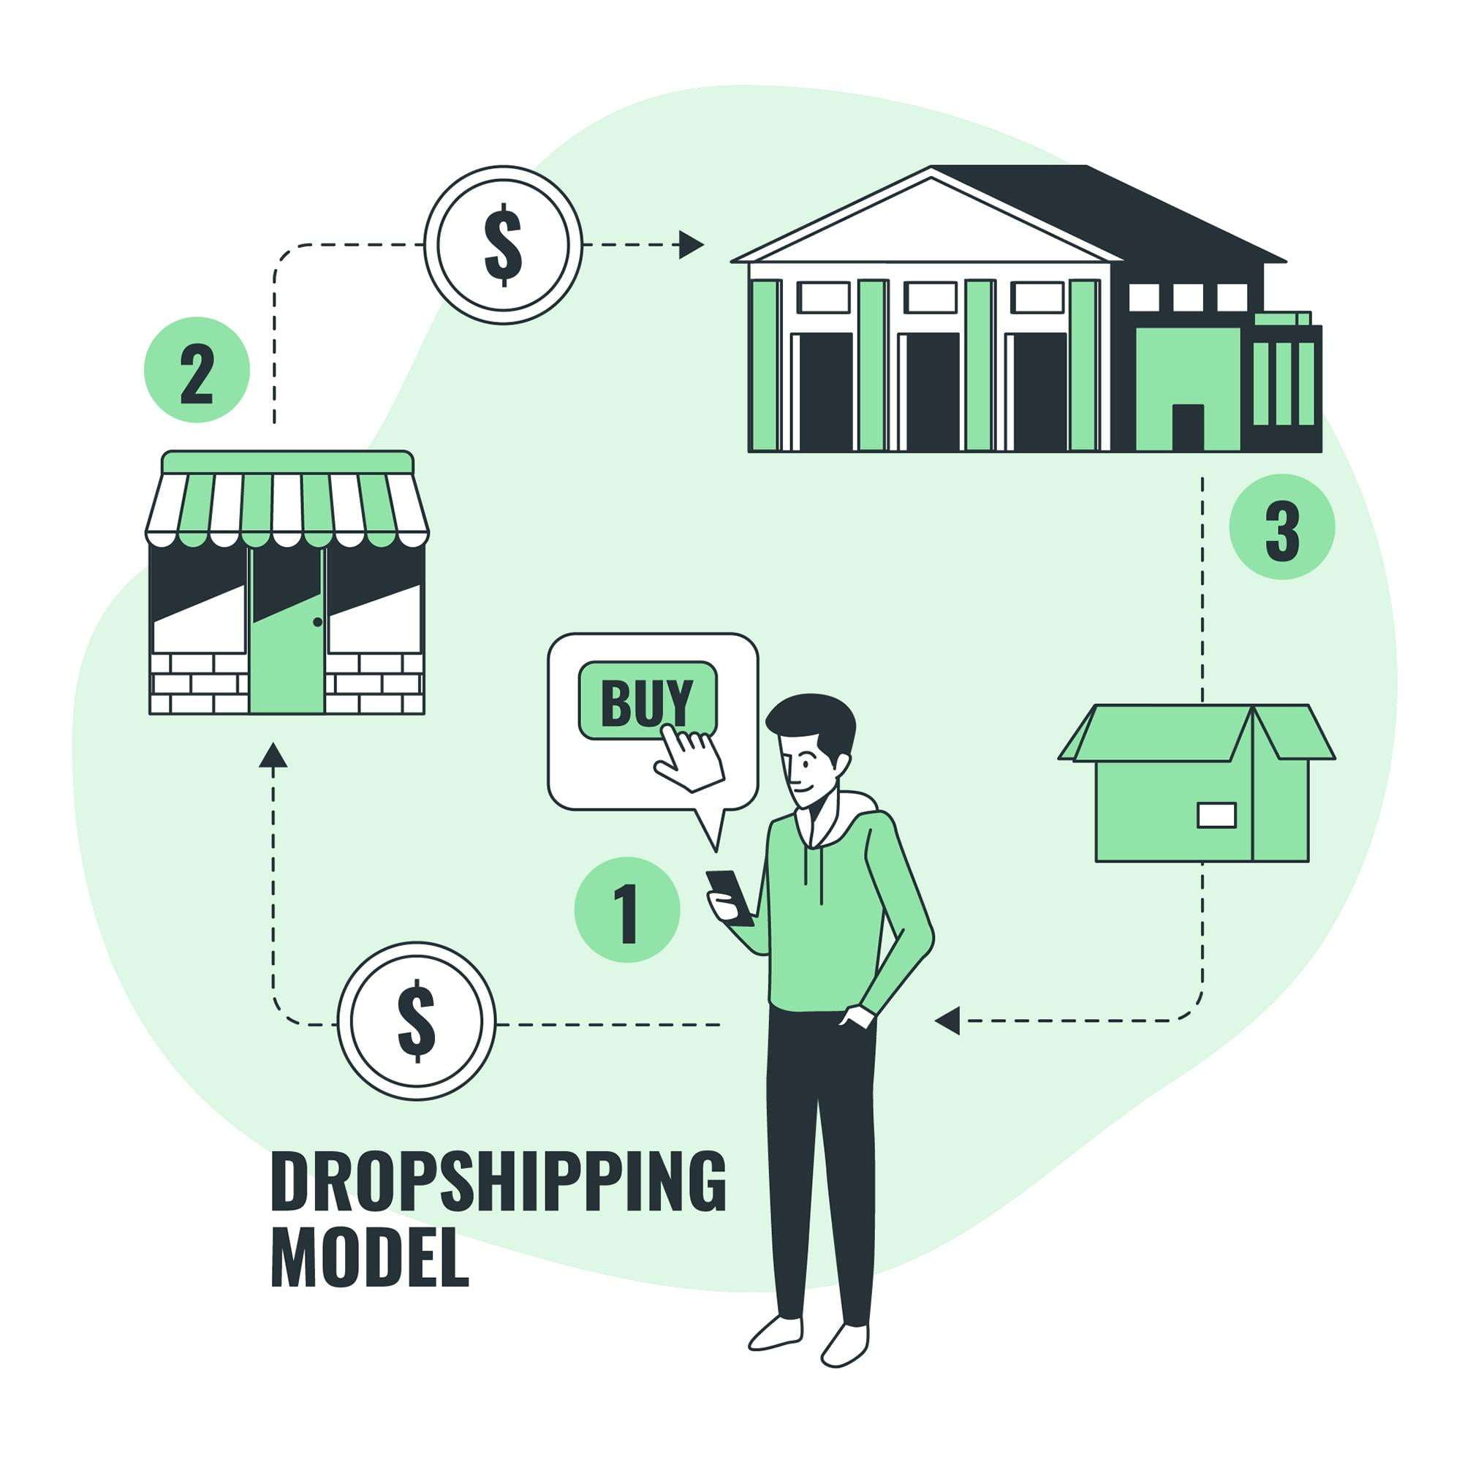


The Business Model of Shopify
E-commerce Platform
Shopify is an e-commerce platform that allows individuals and companies to create an online store and sell their products.
Dropshipping Integration
Shopify also integrates with a variety of third- party applications to make dropshipping easy for its users.
Customizable Storefronts
Shopify provides customizable storefronts for its users to make their business stand out from the competition.
Analytics & Metrics
Shopify provides analytics and metrics to allow users to track their sales, inventory, and other key performance indicators.

Slide 3

Revenue Streams of Shopify
Transaction Fees
Shopify also charges a transaction fee for each sale made through its platform, ranging from 0.5% to 2% depending on the plan. However, users can lower this fee by using Shopify's own payment gateway.
1
2
3
Subscription Fees
Add-Ons & Services
Shopify charges its users a monthly subscription fee to use its platform and services, ranging from $29 to $299 per month depending on the plan
Shopify offers a variety of add-ons and services to its users, such as custom domains, SSL certificates, and shipping and accounting integrations.

Slide 4
Users of Shopify
Small Business Owners
Entrepreneurs
Large Corporations
Shopify's platform is perfect for small business owners looking for an affordable and easy-to-use e-commerce solution.
Entrepreneurs looking to start a business without the overhead of an on-premise store can use Shopify as a cost-effective alternative.
Shopify's platform can be used by large corporations as well, especially those with multiple brands or product lines.

Slide 5
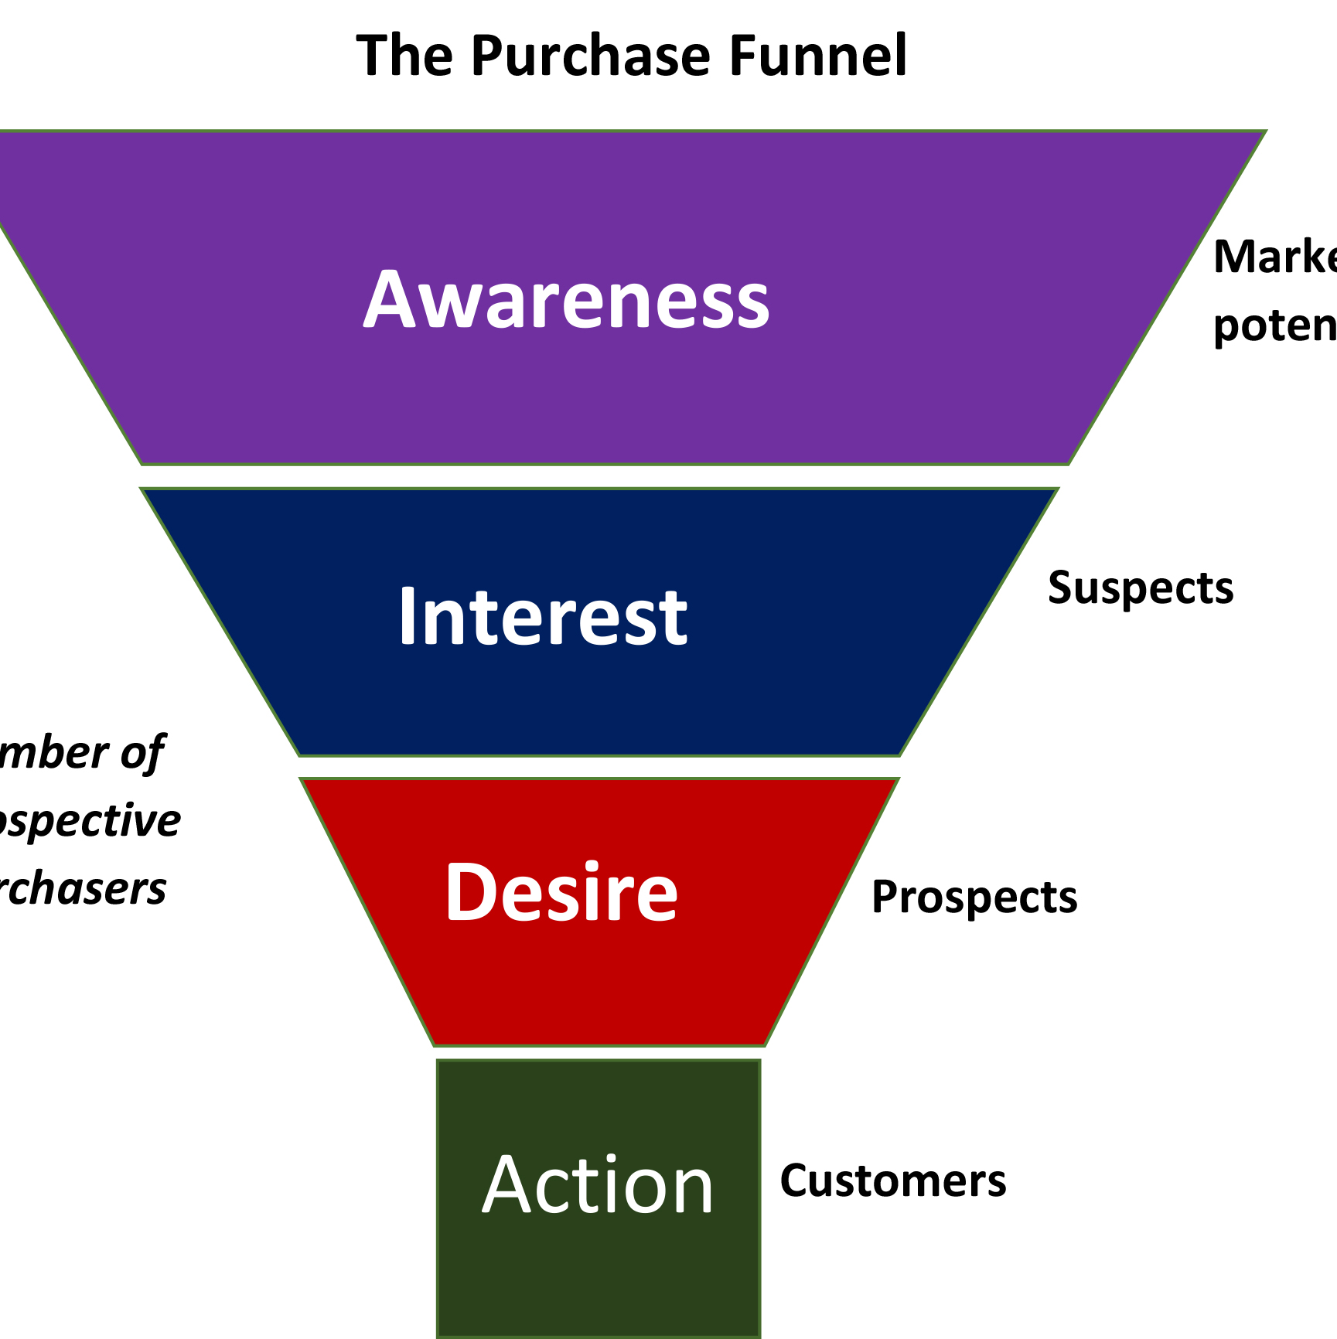
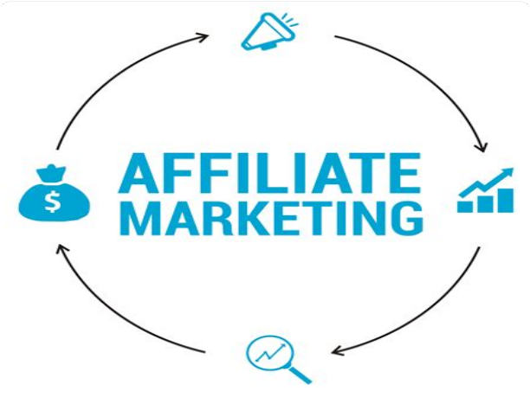
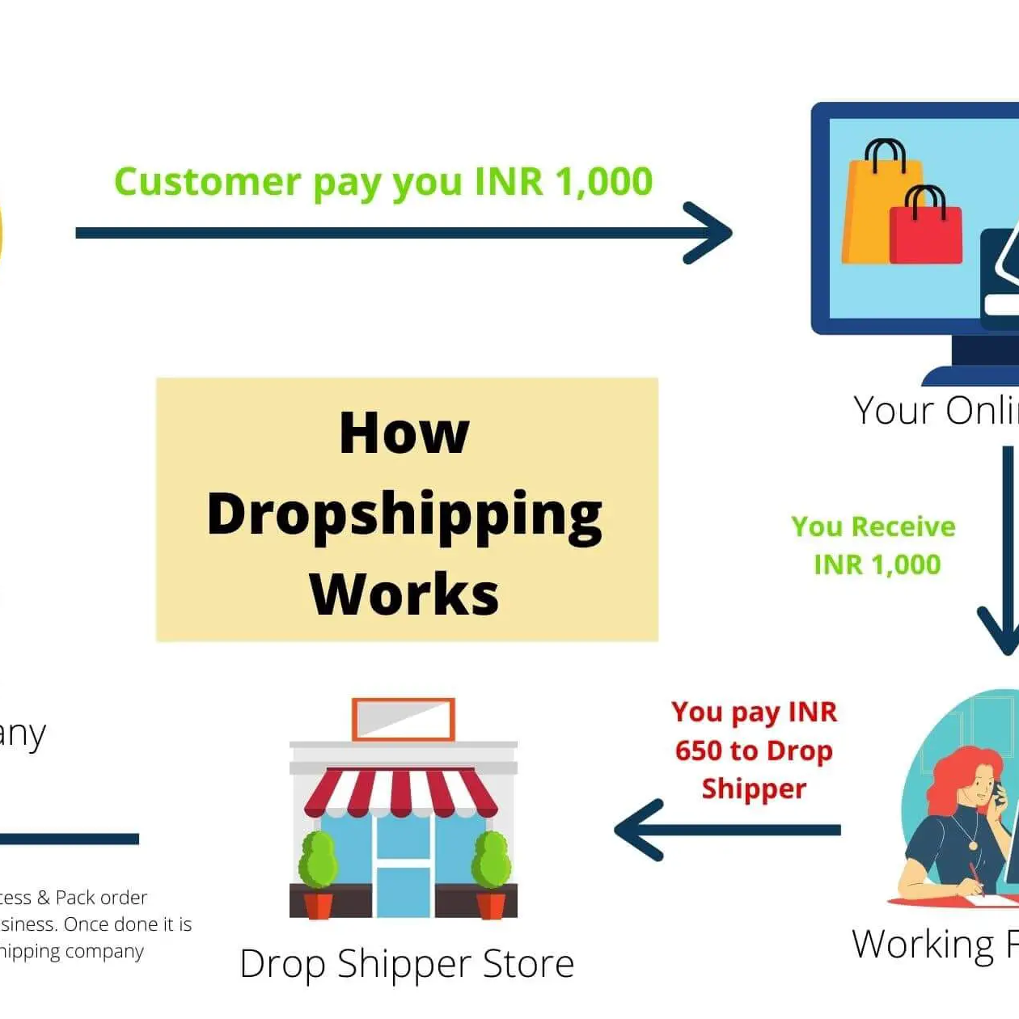

How Users Make Money on Shopify
Sales Funnel
Users can create a sales funnel on Shopify to increase their revenue, such as offering upsells or discounts for multiple purchases.
Affiliate Marketing
Shopify allows users to create an affiliate program and incentivize users to promote their products.
Dropshipping
Users can use Shopify's dropshipping integration to sell products from third-party suppliers without holding inventory.
Subscription Model
Users can set up a subscription model on Shopify to provide predictable revenue and create a loyal customer base.

Slide 6

The Future of Shopify
1 2
Expansion into New Markets
Shopify has expanded beyond its e-commerce platform to provide additional services such as point-of-sale solutions and marketing tools.
Continued Growth
Shopify's user base and revenue continue to grow year over year, indicating a promising future for the company.
3
Innovative Features
Shopify is constantly innovating, with new features such as augmented reality and voice search to improve the user experience.

Slide 7
Related Content
The Benefits of Using Shopify
Easy to use
Low start-up costs Customizable storefronts
Shopify vs. Other E- Commerce Platforms
Shopify vs. WooCommerce Shopify vs. Magento Shopify vs. BigCommerce
Selling on Shopify: Tips & Tricks
Optimizing product listings Driving traffic to your store Cross-selling and upselling

